Slide 1
COLEGIO DE FOMENTO
MONTEAGUDO-NELVA
CENTRO BILINGÜE
Technologies

Slide 2
contents
Technological process
Technology and society
House Design
Structural Forces
Building materials
Ecofriendly Houses
Household utilities
Graphic expression and communication
Scales
Perpectives
Hardware and operating systems
Computer Elements
Using computer in technology classes
Electricity

Slide 3
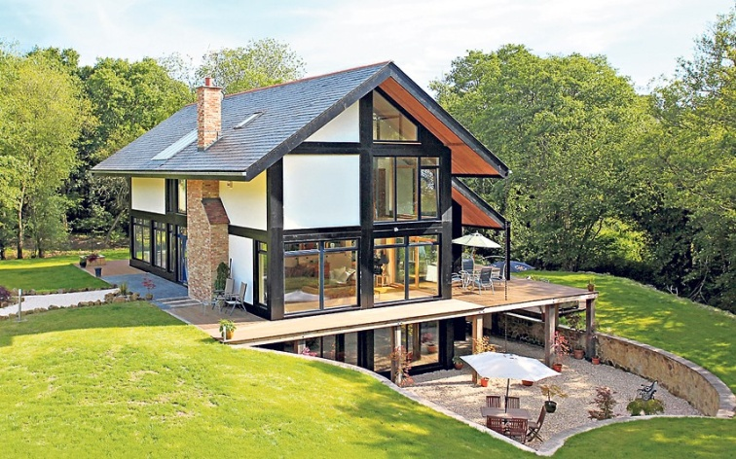
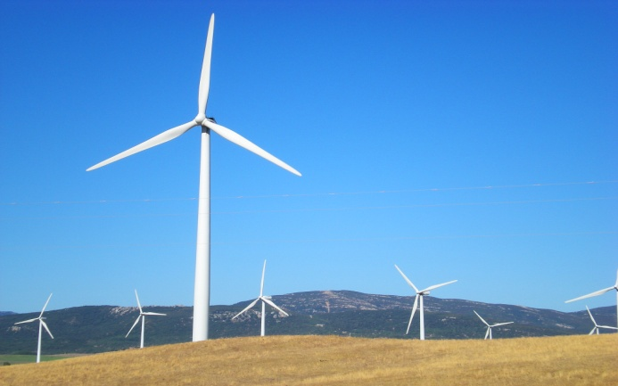
projects
Project I: eco friendly house contest
Project II: airgenerator

Slide 4
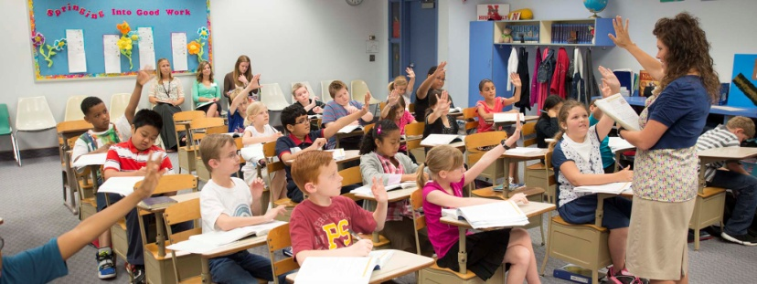
Evaluation tools
1. Class Observations.
2. Student’s Folder
3. Class Activities
4. Projects
5. Leadership
6. Tidiness and behaviour

